Slide 1
Java
UNIT 4(b)

Slide 2
To access method of parent class with super
The super keyword can also be used to invoke parent class method.
It should be used if subclass contains the same method as parent class. In other words, it is used if method is overridden.

Slide 3
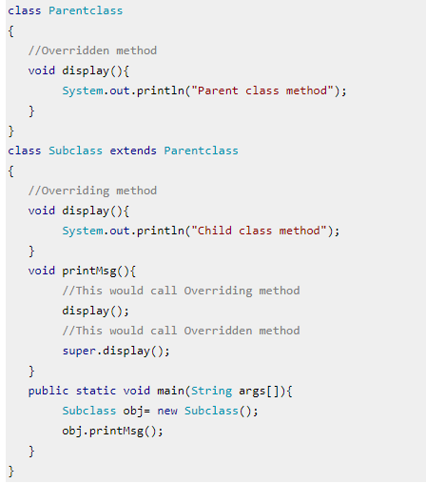
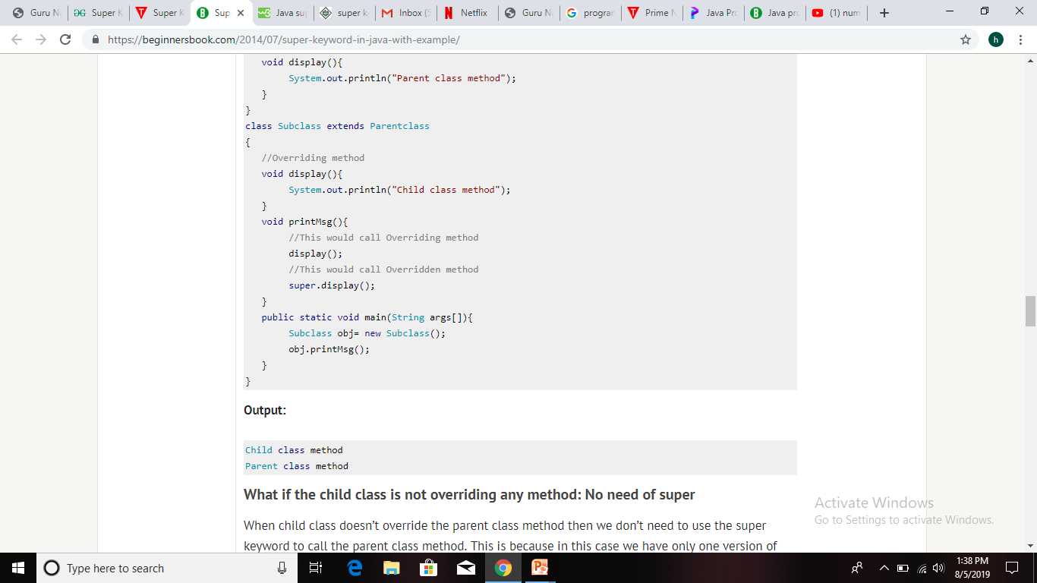

Slide 4
To access constructor of parent class with super
When we create the object of sub class, the new keyword invokes the constructor of child class, which implicitly invokes the constructor of parent class. So the order to execution when we create the object of child class is: parent class constructor is executed first and then the child class constructor is executed.
It happens because compiler itself adds super()(this invokes the no-arg constructor of parent class) as the first statement in the constructor of child class.

Slide 5
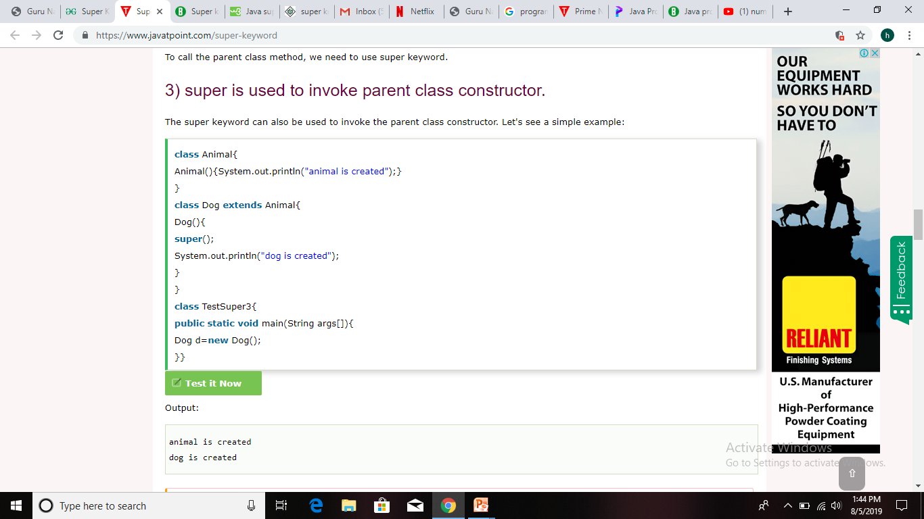
To access constructor of parent class with super

Slide 6
Method overriding
If subclass (child class) has the same method as declared in the parent class, it is known as method overriding in Java.
In other words, If a subclass provides the specific implementation of the method that has been declared by one of its parent class, it is known as method overriding.
It is also called Dynamic Method Dispatch.

Slide 7
Usage of Java Method Overriding
Method overriding is used to provide the specific implementation of a method which is already provided by its superclass.
Method overriding is used for runtime polymorphism

Slide 8
Rules for Java Method Overriding
The method must have the same name as in the parent class
The method must have the same parameter as in the parent class.
There must be an IS-A relationship (inheritance).

Slide 9
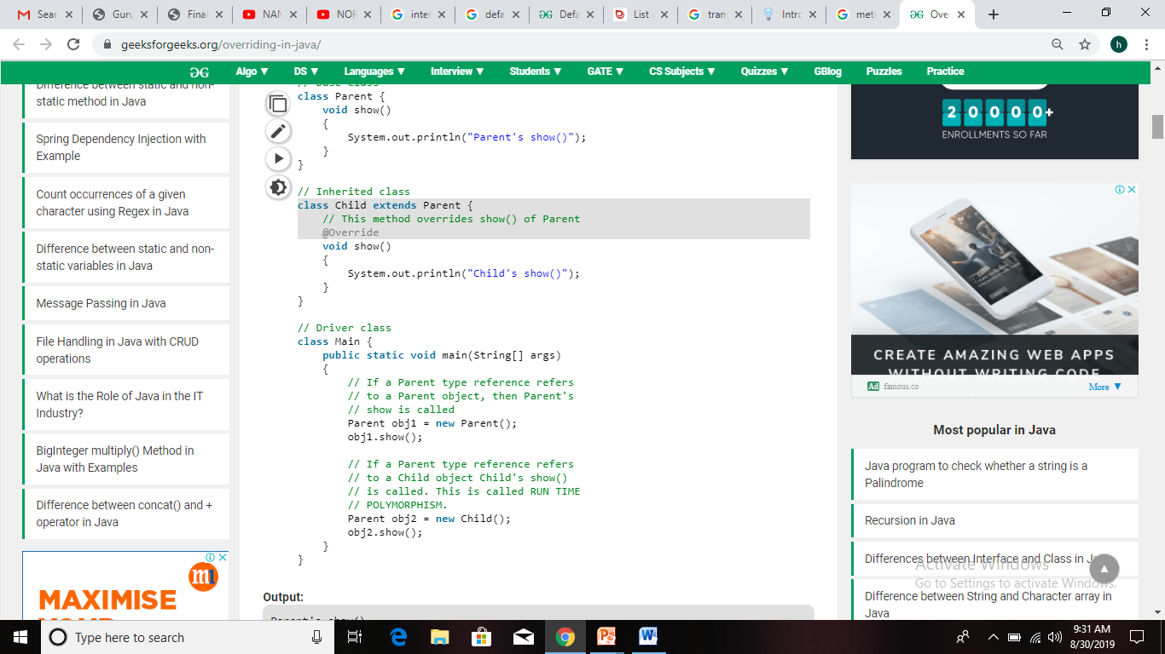
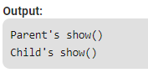
Method overriding

Slide 10
Dynamic Method Dispatch
Runtime polymorphism or Dynamic Method Dispatch is a process in which a call to an overridden method is resolved at runtime rather than compile-time.
In this process, an overridden method is called through the reference variable of a superclass. The determination of the method to be called is based on the object being referred to by the reference variable.
Let's first understand the upcasting before Runtime Polymorphism.

Slide 11
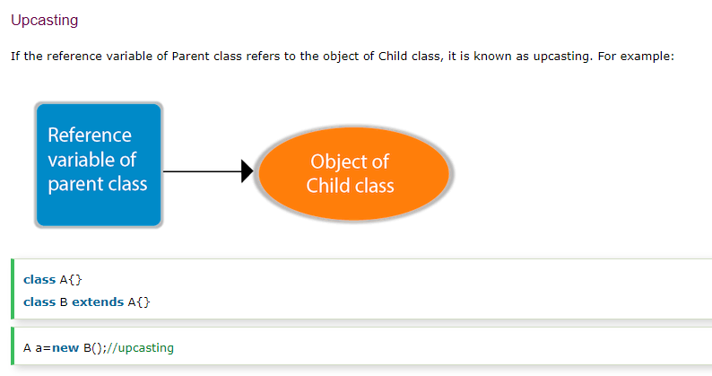
Upcasting

Slide 12
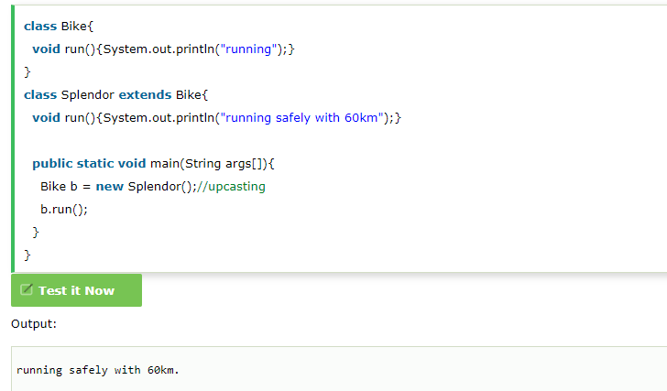
Dynamic Method Dispatch

Slide 13
Abstract class
A class which is declared with the abstract keyword is known as an abstract class in Java. It can have abstract and non-abstract methods (method with the body).
Why abstract class?......To achieve abstraction.
There are two ways to achieve abstraction in java:
Abstract class (0 to 100%)
Interface (100%)

Slide 14
Abstract class
A class which is declared as abstract is known as an abstract class.
It can have abstract and non-abstract methods.
It needs to be extended and its method implemented.
It cannot be instantiated but we can create reference of abstract class.
An abstract class must be declared with an abstract keyword.
It can have constructors and static methods also.
It can have final methods which will force the subclass not to change the body of the method.

Slide 15
Abstract Method in Java
A method which is declared as abstract and does not have implementation is known as an abstract method.
Syntax:
abstract void printStatus();
// no method body

Slide 16
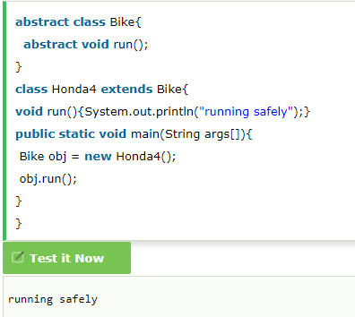
Abstract class

